Slide 1

Scott D. Cole, COSS, CSP
colesafety3@yahoo.com

Slide 2
What is GHS?
UN-developed system for chemical classification and hazard communication through harmonized provisions.
The goal is to develop an international system that has compatible labeling, material safety data sheets, and other information based on resulting classifications.

Slide 3
Benefits of GHS?
Enhanced protection of human health and the environment.
Promotes uniform chemical management across countries.
Facilitates trade by reducing regulation compliance barriers.

Slide 4
Hazard Communication
Information = Protection
Confusion = Risk
Clarity / Simplicity / Consistency = Harmonization

Slide 5
Risk Reduction Model
Potential Risk
Risk Assessment | Risk Management | Risk Mitigation | Risk Communication
Identification and characterization through sound data and science | Determination of effective requirements to ensure safety | Clear understanding and effective use of controls practices | Informed employees of changes in order to make sound personal risk decisions
Safe Use

Slide 6
GHS Timeline
1992 – UN Subcommittee Proposal
September 2009 – Proposed Rulemaking
March 2010 – Public Hearings
March 2012 – Official Adoption by US
December 1, 2013
Train employees on the new label elements and SDS format

Slide 7
Timeline Continued
June 2015 – Comply with all provisions of the final rule; except,
***Distributors may ship products labeled by manufacturers under the old system until December 1, 2015.

Slide 8
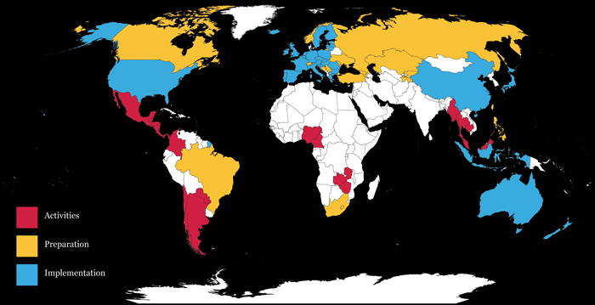
Current Implementation

Slide 9
OSHA GHS Facts - Costs
Reclassification and revising safety data sheets $22.5MM
Training $95.4MM
Management $59MM
Printing $24.1MM
Total Cost / Year: $201MM

Slide 10
OSHA GHS Facts - Savings
Prevent 500 workplace injuries and illnesses and 43 fatalities annually
Cost savings to American businesses of more than $475MM
  Productivity improvements
  Fewer safety data sheets and label updates
  Simpler hazard communication training

Slide 11
Hazard Communication
1983
Major changes include:
Hazard Classification
Labeling
Safety Data Sheets
Training

Slide 12

1. Hazard Classification
HCS = performance-oriented
GHS = criteria-based

Slide 13
2. Labeling
Standardized requirements
Pictogram
Signal words
Hazard statement
Precautionary statement

Slide 14

Symbol Savvy

Slide 15

Symbol Savvy

Slide 16

Symbol Savvy

Slide 17

Symbol Savvy

Slide 18

Symbol Savvy

Slide 19
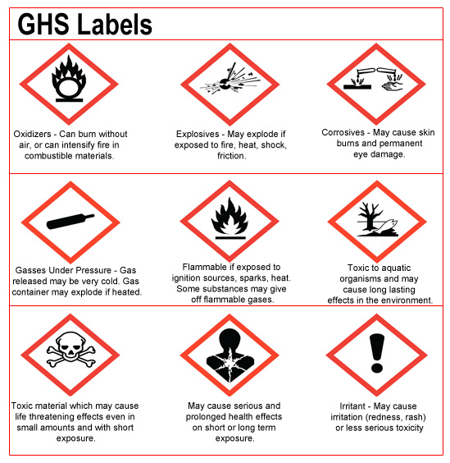
2. Labeling

Slide 20
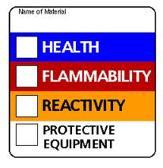

2. Labeling

Slide 21
2. Labeling
Signal words
Danger
Severe hazards
Warning
Less severe hazards

Slide 22
2. Labeling
Hazard statement
Assigned statement to a hazard class and category
Category 1 – Extremely flammable liquid or vapor
Category 2 – Highly flammable liquid or vapor
Category 3 - Flammable liquid or vapor
Category 4 – Combustible liquid

Slide 23
2. Labeling
Precautionary statement
Recommended measures to minimize or prevent adverse effects

Slide 24
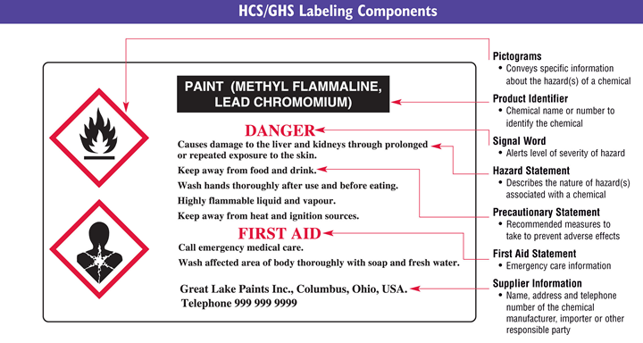

Slide 25
3. Safety Data Sheets
Standardized requirements
Specific headings
Specific sequence

Slide 26
3. Safety Data Sheets
Identification
Hazard identification
Composition
First-aid measures
Fire-fighting measures
Accidental release measures
7. Handling and storage
8. Exposure controls / personal protection
9. Physical and chemical properties
10. Stability and reactivity
11. Toxicological information

Slide 27
3. Safety Data Sheets
12. Ecological identification
13. Disposal considerations
14. Transport information
15. Regulatory information
16. Other information, including date of preparation or last revision

Slide 28
4. Training
Must include:
Current HCS program elements
New label elements
SDS format

Slide 29
HazCom 2012
Update / modify to include:
  Labeling changes
  SDS communications
  Employee training

Slide 30

GHS =
Questions?

